Slide 1

Observing users

Slide 2
The aims
    Discuss the benefits & challenges of different types of observation.
    Describe how to observe as an on-looker, a participant, & an ethnographer.
    Discuss how to collect, analyze & present observational data.
    Examine think-aloud, diary studies & logging.
    Provide you with experience in doing observation and critiquing observation studies.

Slide 3
What and when to observe
Goals & questions determine the paradigms and techniques used.
Observation is valuable any time during design.
Quick & dirty observations early in design
Observation can be done in the field (i.e., field studies) and in controlled environments (i.e., usability studies)
Observers can be:
- outsiders looking on
- participants, i.e., participant observers
- ethnographers

Slide 4
Frameworks to guide observation
- The person. Who?
- The place. Where?
- The thing. What?
The Goetz and LeCompte (1984) framework:
- Who is present?
- What is their role?
- What is happening?
- When does the activity occur?
- Where is it happening?
- Why is it happening?
- How is the activity organized?

Slide 5
The Robinson (1993) framework
Space. What is the physical space like?
Actors. Who is involved?
Activities. What are they doing?
Objects. What objects are present?
Acts. What are individuals doing?
Events. What kind of event is it?
Goals. What do they to accomplish?
Feelings. What is the mood of the group and of individuals?

Slide 6
You need to consider
Goals & questions
Which framework & techniques
How to collect data
Which equipment to use
How to gain acceptance
How to handle sensitive issues
Whether and how to involve informants
How to analyze the data
Whether to triangulate

Slide 7
Observing as an outsider
As in usability testing
More objective than participant observation
In usability lab equipment is in place
Recording is continuous
Analysis & observation almost simultaneous
Care needed to avoid drowning in data
Analysis can be coarse or fine grained
Video clips can be powerful for telling story

Slide 8
Participant observation & ethnography
Debate about differences
Participant observation is key component of ethnography
Must get co-operation of people observed
Informants are useful
Data analysis is continuous
Interpretivist technique
Questions get refined as understanding grows
Reports usually contain examples

Slide 9
Data collection techniques
Notes & still camera
Audio & still camera
Video
Tracking users:
- diaries
- interaction logging

Slide 10
Data analysis
Qualitative data - interpreted & used to tell the ‘story’ about what was observed.
Qualitative data - categorized using techniques such as content analysis.
Quantitative data - collected from interaction & video logs. Presented as values, tables, charts, graphs and treated statistically.

Slide 11
Interpretive data analysis
Look for key events that drive the group’s activity
Look for patterns of behavior
Test data sources against each other - triangulate
Report findings in a convincing and honest way
Produce ‘rich’ or ‘thick descriptions’
Include quotes, pictures, and anecdotes
Software tools can be useful e.g., NUDIST, Ethnograph (see URL resource list for examples)

Slide 12
Looking for patterns
Critical incident analysis
Content analysis
Discourse analysis
Quantitative analysis - i.e., statistics

Slide 13
Key points
Observe from outside or as a participant
Analyzing video and data logs can be time-consuming.
In participant observation collections of comments, incidents, and artifacts are made. Ethnography is a philosophy with a set of techniques that include participant observation and interviews.
Ethnographers immerse themselves in the culture that they study.

Slide 14
ActiveWorlds …An ethnographic project for you …
Join ActiveWorld.com if you have a high speed Internet connection or go to another chat room of your choice.
ActiveWorlds is a 3-D chatroom environment in which you can visit different environments and chat with the people that you meet there.
To use ActiveWorlds you will need to check the instructions that they provide and download the appropriate software to run on your computer.
The next slide shows the Yellowstone world.

Slide 15
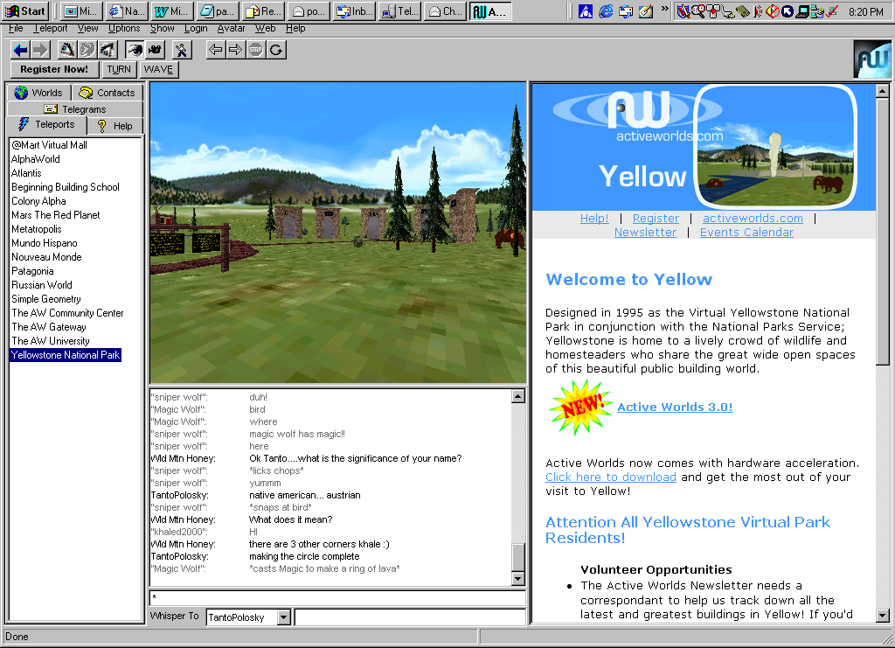

Slide 16
Select one of the worlds to visit and choose an avatar (a graphical personification) to represent you.
Spend one to two hours doing a participant observation study.
Use one of the frameworks discussed in the previous slides to guide you and write a one-two page report about your study.
Also notice and report on any usability issues you encounter and on user experiences in this environment. (Chapters 1, 4 and 5 discuss user experience criteria that are relevant.)

